Slide 1
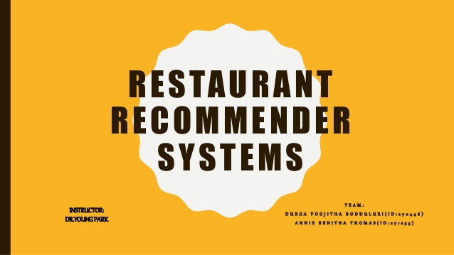
PREPARED BY-
BIKRAM BISWAS,KASHIF MUKHTAR

Slide 2
CONTENTS
TOPIC PAGE NO.
ACKNOWLEDGEMENT 3
INTRODUCTION 4
FEATURES 5
DATA SET 6
QUERIES AND ARCHITECTURE 7-9
CHALLENGES 10
TOOLS AND LANGUAGES 11
CONCLUSION 12

Slide 3
ACKNOWLEDGEMENT
We would like to express my special thanks of gratitude to our teacher WONG mam, who gave us the golden opportunity to do this wonderful project on the topic RESTAURANT RECOMMENDER SYSTEM which also helped us in doing a lot of Research and we came to know about so many new things I am really thankful to mam.
Secondly we would also like to thank our parents and friends who helped us a lot in finalizing this project within the limited time frame.

Slide 4
INTRODUCTION:
Over the last decade an increasing intersest in preference queries has witnessed
The reason behind that increasing concern comes from
It is desirable to offer flexible queries that meet the user’s minds
These queries usually provide a basis for rank-ordering the objects retrieved
Thus,we have developed a restaurant recommendation system to satisfy the users’s request
In this system alist of restaurants is shown to the user based in certain queries.
Five attributes are involved in this query system , namely cuisine,location,price-level,rating and timing.

Slide 5
FEATURES:
For this project, we are using the Zomato API.Zomato APIs give you access to the freshest and most exhaustive information for over 1.5 million restaurants across 10,000 cities globally
By Collecting the data using Zomato API one can recommend restaurants on the basis of user’s affinity to specific cuisines, establishment types, locations, and price bands.
We can find out whether restaurant support online reservation or not.
We can find what is the most popular and/ or exclusive/new at a given location & time.
Moreover it will also recommend the famous food of that location and the
most ordered food by the user

Slide 6
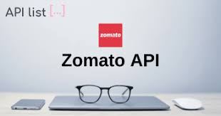
DATASET:
We utrilize a real time dataset crawled from google to give the
users the opportunity to interact and experience how the system
can be used for retrieving the restaurants
No noisy data ,such as incomplete or missing data
Live dataset obtained by using Zomato API
The dataset consists of various types of attributes
The attributes were divided into groups based on the query category
Range category(Cuisine,Distance)
Skyline category(distance,price,rating)
Notes:
6

Slide 7
QUERIES AND ARCHITECTURE:
The user submits a query through the user interface and the query is sent to the system for processing
After the query is processed ,the results are sent back to the user and displayed on the Google Maps
What’s more?
The system suggests the most dominating restaurants in the selected region and based chosen attributes
Queries are based on the relationship
For instance given two subjects p and q,p dominates q if this condition holds
1.For every dimension i either p[i] is no worse than q[i]
2.There is at least one dimension j ,in which p[j] and q[j] are observed and p[j] is better than q[j]

Slide 8
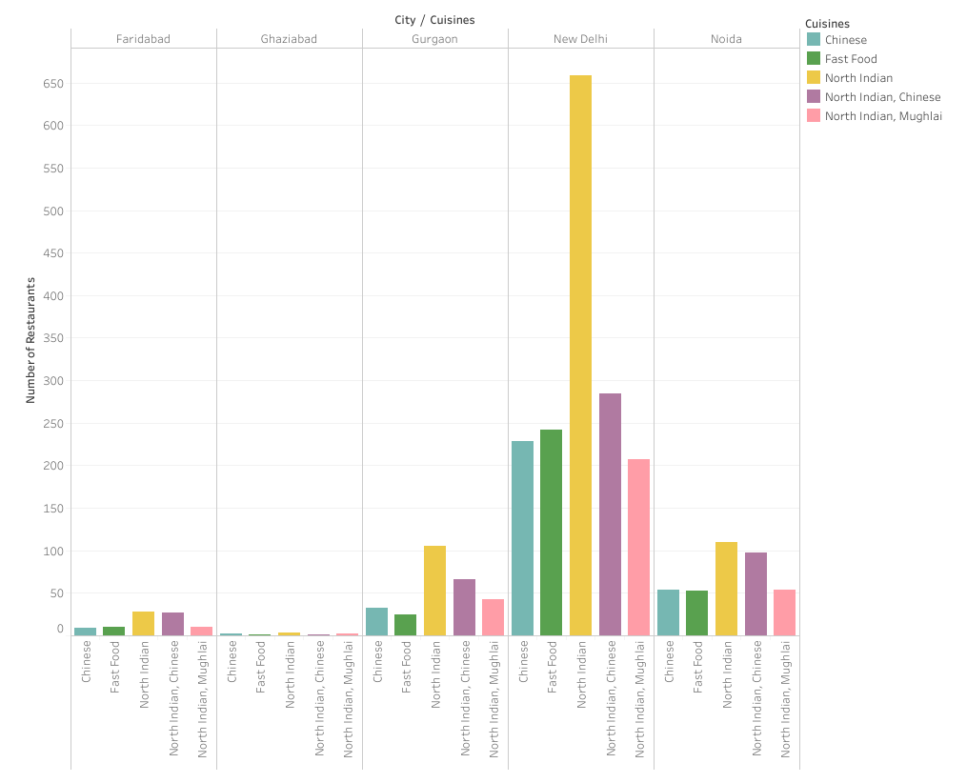
A small analysis of top 5 restauants in India

Slide 9
QUERIES AND ARCHITECTURE: (cont.)
1.Price ,Lower price dominates the higher prices
2.Distance,Nearer distance dominates the far distance
3.Score(rating),Higher score dominates the lower scores
score=5.0-original rating

Slide 10
Challenges:
1. Integration:
Zomato api
Graphical analysis tools
2.Feature selection
Primary features
Secondary features
3.Quality testing

Slide 11
Tools and Languages:
HTML,CSS,JAVASCRIPT(FRONT-END)
NODEJS(EXPRESS)(BACKEND)
JSON
MONGO DB AND ZOMATO API(DATA BASES)
GITHUB
Notes:
<number>

Slide 12
CONCLUSION
.
1.In this project we developed a restaurants recommendation system based on preference queries
2.The recommended restaurants can be visualized in graphs
3.The system is based on real time zomato dataset and its important datas
Notes:
<number>

Slide 13
THANK YOU

